Slide 1
VISUAL ANALYSIS OF terrorism Counter Measuring
Notes:
Line spacing + Page numbers

Slide 2
Agenda
Team
Introduction
Abstract
Methodology
Exp&Results
Future Works
Conclusion

Slide 3
TEAM MEMBERS
Sheryas (19BCE1129)
Tarun Sairam (19BPS1095)
Saimouli (19BPS1124)

Slide 4
Introduction
World peace was one of the core reasons for forming the United Nations organization. Terrorism is the biggest hurdle to world peace.
Terrorism is commonly ignored by the civilians who are not affected directly by the dangers. For the most part, terrorism is considered unpredictable and unfortunate calamity that strikes some parts of the world more than others.
In this project, we focus on terrorism by analysing the dataset provided by START (Study of Terrorism and Response to Terrorism) Consortium to explore meaningful patterns and statistics.

Slide 5
Abstract
The main objective is to visualize terrorism data and make it available to users in an easy to understand format. A project is designed which contains a collection of various analyses and visualizations to interpret patterns and trends in it. The project also contains a visualization tool that provides the user with dataset exploration capabilities. Lack of understanding and awareness about global terrorism leads to diverse opinions and common misconceptions among civilians.

Slide 6
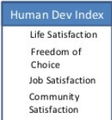



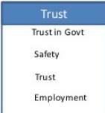

LITERATURE REVIEW
There are parameters like religion or nationalism which are not defined in the dataset but have a major influence on contemporary terrorism
Religion has been a very controversial topic among researchers about whether religion influences terrorism or not and if it does,
up to what extent.
Government idealization has been one of the major motivating factors leading to fanaticism and in turn, evolve into terrorism

Slide 7
Most of the operations on the dataset are done by R Studio. R is used for data pre-processing, data modelling, analyses, and visualization. Anaconda is used as an open-source python distribution for handling R based dependencies and provide a environment for code development
Methodology

Slide 8
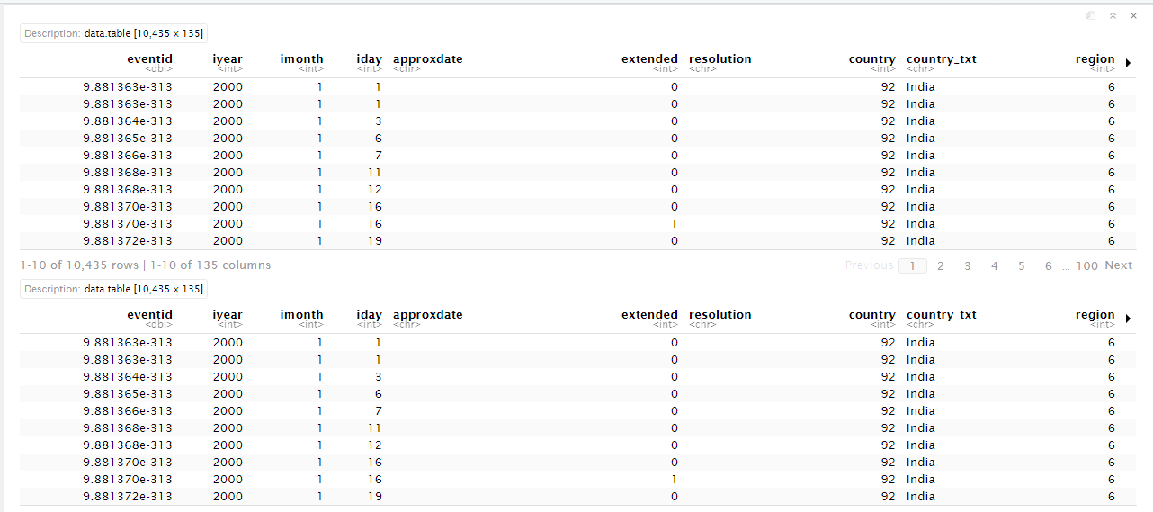
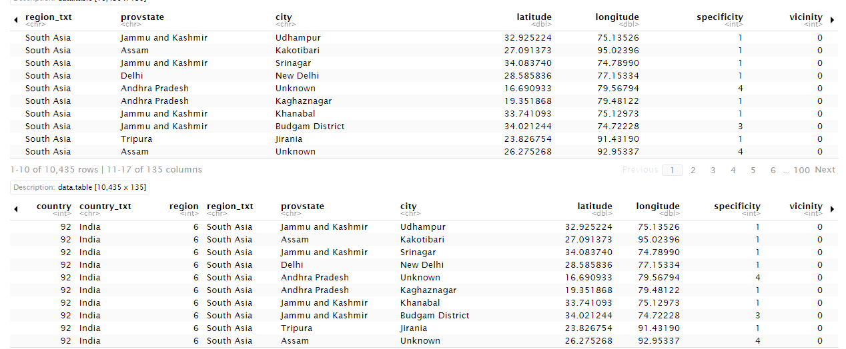
Terrorism faced in India in 2001

Slide 9
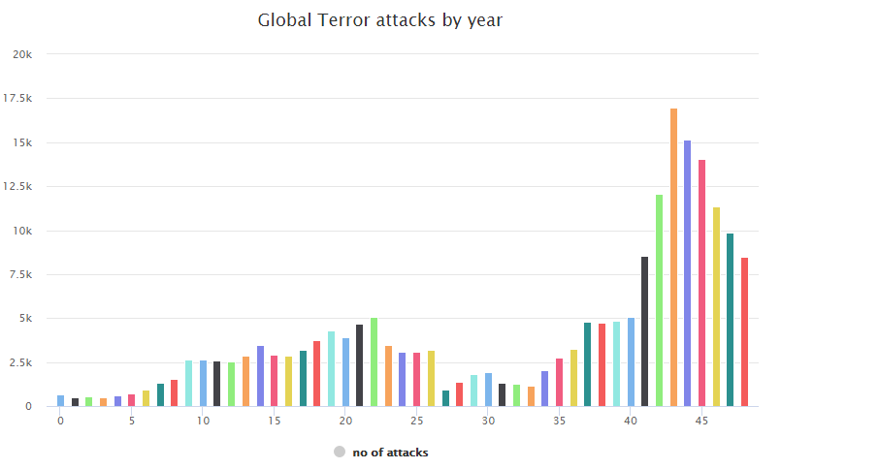
Total No of Attacks by Year

Slide 10
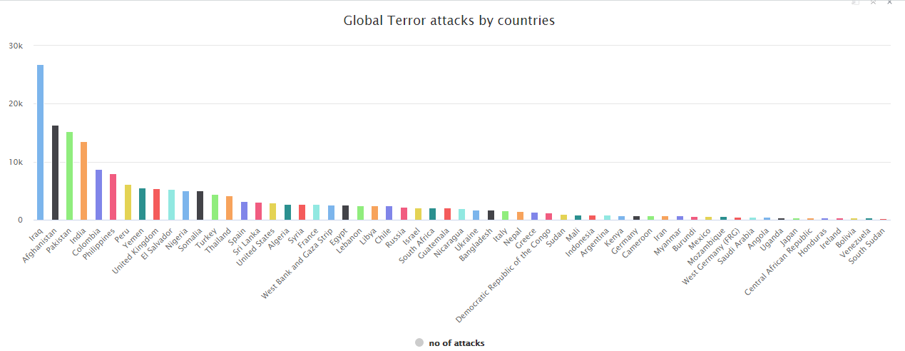
Total No of Attacks by countries

Slide 11
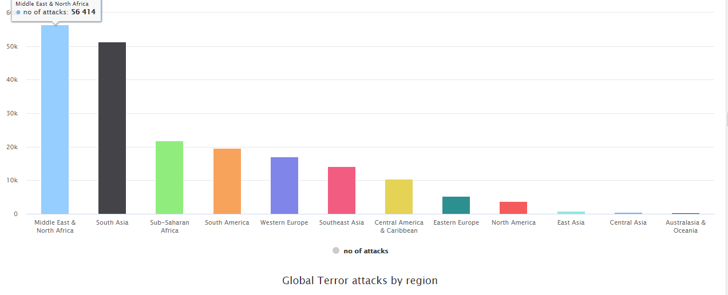
Total No of Attacks by Region

Slide 12
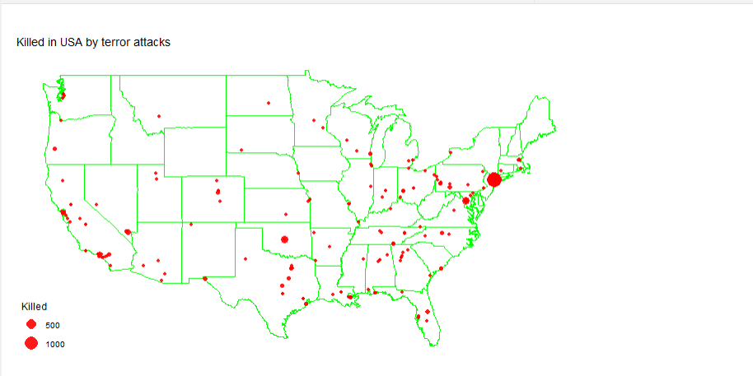
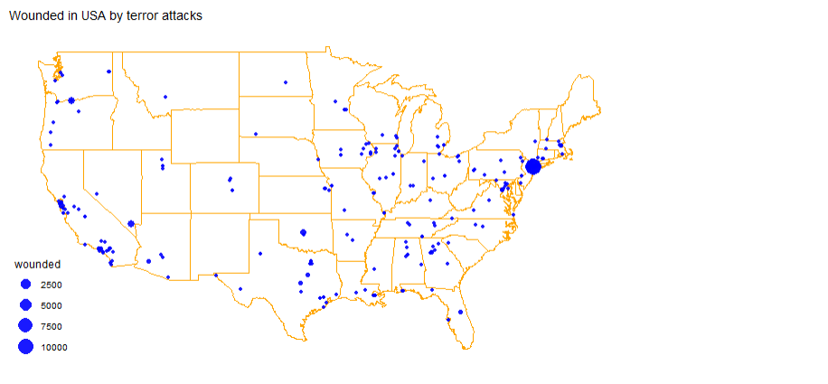
USA Terror attacks

Slide 13
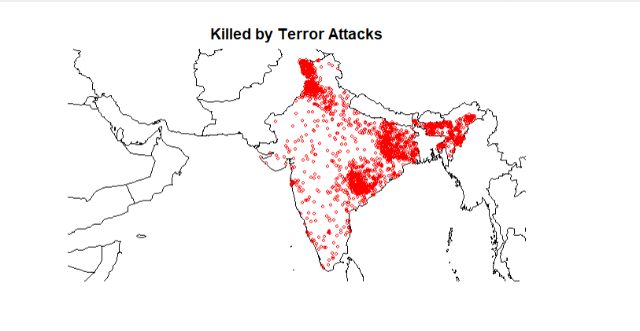
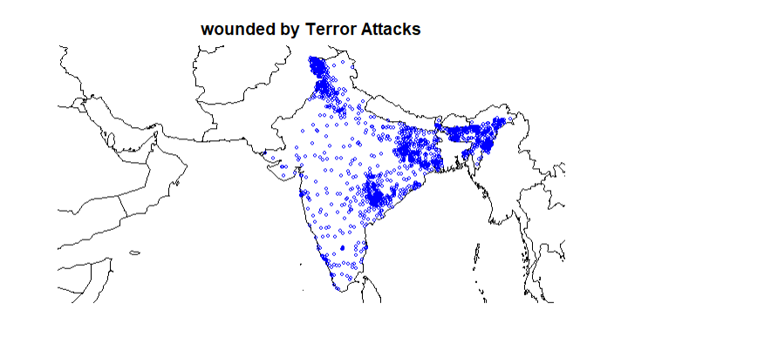
India Terror attacks

Slide 14
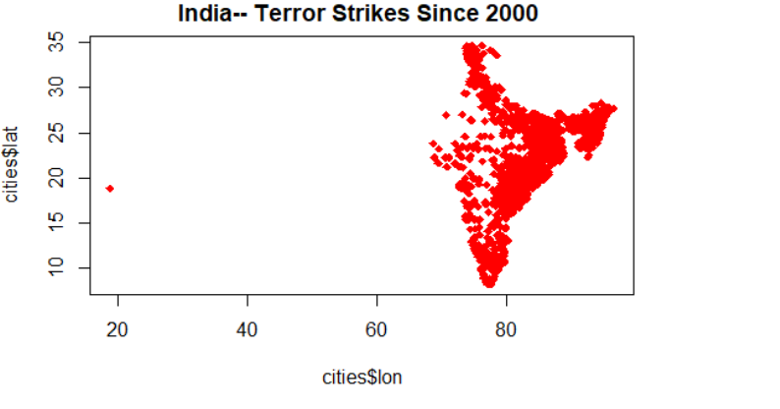
Analysing terror in India

Slide 15
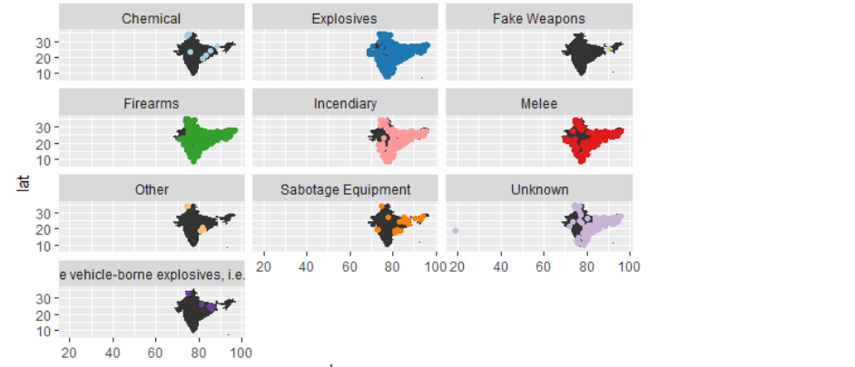
Prominent weapons used

Slide 16
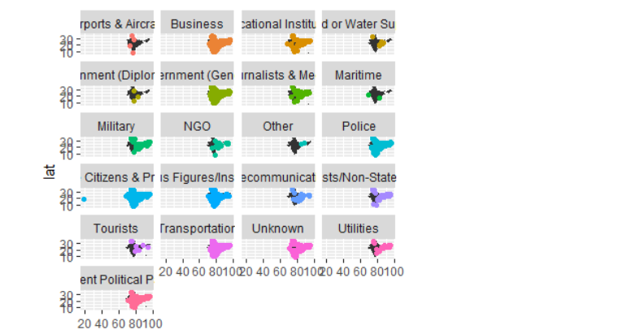
Institutions attacked

Slide 17
Future Work
Following is a list of directions which can enhance the quality and quantity of this current project work:
Improve dataset quality:
Dataset needs to be populated more by adding the missing values. Many historical terrorist events are yet to be documented because of conflict in information from multiple sources or lack of credibility from the source providing information. Resolving this conflict will increase the scope of analysis of new attributes that are mostly sparse at the moment.
Prediction:
Different prediction methodologies can be used to make a system that can predict various parameters like attack count, rate of a successful attack, prospective casualties, type of attack, types of weapons used, etc. Currently, prediction models are difficult to achieve high accuracy because of the relatively small dataset size.

Slide 18
Future Work
Enhance current work:
More techniques can be added in this project like classification and regression. Design sophisticated patterns like how terrorist groups act and react over the years. Add more visualizations to make user interface more interactive.
Connections with other datasets:
Exploring impacts of terrorism on other fields like country’s Development index, stock market, international investments, happiness rating, tourism, etc. can reveal new patterns and relationships among them. These correlations will help understand how terrorism influences other domains.

Slide 19
CONCLUSION
The goal of this project was to build a tool which helps users to understand and interpret the nature of terrorism. Users can perceive the START dataset through visual designs. A visualization which can be used to calculate the total number of attacks, total kill counts and location based on the selected region and year provides interactive interface to explore this dataset. Users can understand various patterns, trends and correlation in terrorism through visual interpretation and its provided explanation. Users can also explore START dataset and other terrorism related sources for additional research purposes provided in this tool. This work can be used by curious civilians, security related policy-makers, international organizations hosting worldwide events, foreign investors and academic researchers for the purpose of understanding terrorism and its nature.

Slide 20
REFERENCE
United Nations, “Chapter-1 Purposes and Principles,” [Online]. Available: https://www.un.org/en/sections/un-charter/chapter-i/index.html [Accessed: May 2019].
A. Z. Borda, “Why we react differently to terror attacks depending on where they happen,” [Online]. Available: http://theconversation.com/why-we-react-differently-to-terror-attacks-depending-on-where-they-happen-57389 [Accessed: May 2019].
START organization, “Global Terrorism Database,” [Online]. Available: https://www.start.umd.edu/gtd/about/ [Accessed: May 2019].

